Slide 1
CAPSTONE PROJECT
MOBILE PRICE PREDICTION BY- NAVNEET SINGH

Slide 2
PROJECT SUMMARY
Cell phones come in all sorts of prices, features, specifications and all. Price estimation and prediction is an important part of consumer strategy. Deciding on the correct price of a product is very important for the market success of a product. A new product that must be launched, must have the correct price so that consumers find it appropriate to buy the product.
We will proceed with reading the data, and then perform data analysis. The practice of examining data using analytical or statistical methods in order to identify meaningful information is known as data analysis. After data analysis, we will find out the data distribution and data types. We will train 4 classification algorithms to predict the output. We will also compare the outputs. Let us get started with the project implementation.

Slide 3
PROBLEM STATEMENT
In the competitive cell phone market companies want to understand sales data of cell phones and factors which drive the prices. The objective is to find out some relation between features of a mobile phone(e.g.:- RAM, Internal Memory, etc) and its selling price. In this problem, we do not have to predict the actual price but a price range indicating how high the price is.

Slide 4
POINTS TO DISCUSS
Getting the dataset
Finding Missing Data
Encoding Categorical Data
Data Cleaning and Feature Engineering
Exploratory data analysis(EDA)
Supervise Machine learning algorithms and implementation
1. Logistic regression
2. Random Forest Classifier
3. XG Boost Classifier

Slide 5
DATA DESCRIPTION
The data contains information regarding cell phone features, specifications etc and their price range. The various features and information can be used to predict the price range of a cell phone.
Battery power - Total energy a battery can store in one time measured in mAh
Blue - Has Bluetooth or not
Clock speed - speed at which microprocessor executes instructions
Dual sim - Has dual sim support or not
Fc - Front Camera mega pixels
Four g - Has 4G or not
Int memory - Internal Memory in Gigabytes
M dep - Mobile Depth in cm
Mobile wt - Weight of cell phone

Slide 6
DATA DESCRIPTION (CONT.)
N cores - Number of cores of processor
Pc - Primary Camera mega pixels
Px height - Pixel Resolution Height
Px width - Pixel Resolution Width
Ram - Random Access Memory in Mega
Touch screen - Has touch screen or not
Sc h - Screen Height of mobile in cm
Sc w - Screen Width of mobile in cm
Talk time - longest time that a single battery charge will last on call
Three g - Has 3G or not
Wifi - Has Wi-Fi or not
Price range - This is the target variable with value of 0(low cost), 1(medium cost), 2(high cost) and 3(very high cost).

Slide 7
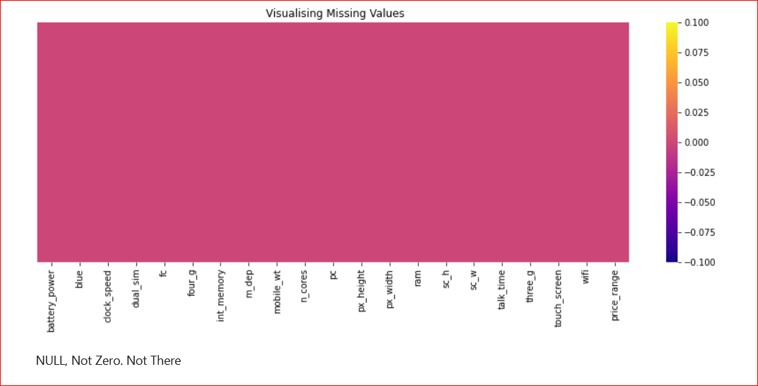
As we can see in the above graph there is no missing values

Slide 8
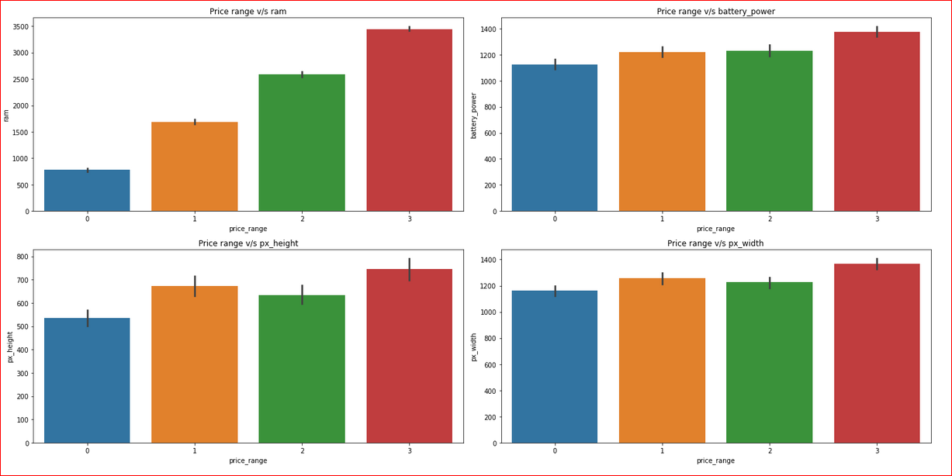
MOBILES HAVING RAM MORE THAN 3000 MB FALLS UNDER VERY HIGH-COST CATEGORY. AS RAM INCREASES PRICE RANGE ALSO INCREASES. MOBILES HAVING RAM LESS THAN 1000 MB FALLS UNDER LOW-COST CATEGORY. MOBILES WITH BATTERY POWER MORE THAN 1300 MAH HAS VERY HIGH COST. AND MOBILES WITH BATTERY POWER BETWEEN 1200 AND 1300 MAH FALLS UNDER MEDIUM AND HIGH-COST CATEGORY. MOBILES WITH MORE THAN 700-PIXEL HEIGHT AND WIDTH MORE THAN 1300 HAS VERY HIGH COST.

Slide 9
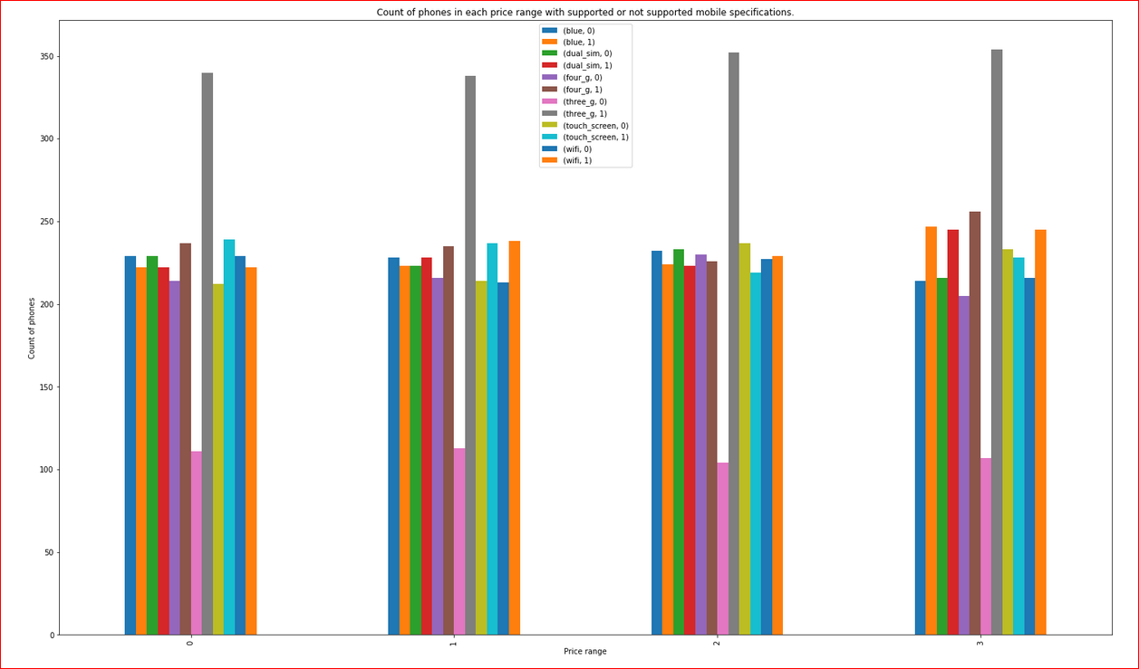
WE CAN SEE THAT EACH PRICE RANGE CATEGORY HAS EQUAL NUMBER OF MOBILES PHONES HAVING BOTH SUPPORTING AND NON SUPPORTING SPECIFICATIONS. IT WILL HELP TO GAIN INSIGHT TO HELP CREATING A POSITIVE BUSINESS IMPACT.

Slide 10
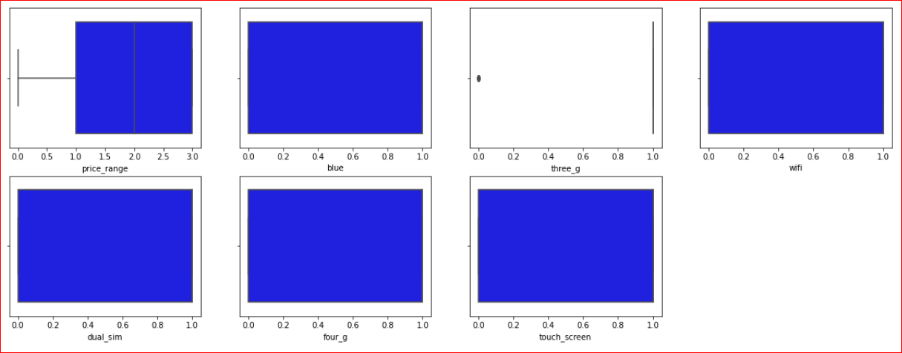
WE HAVE CREATED A SEPARATE COLUMNS FOR NUMERICAL AND CATEGORICAL VARIABLES TO WORK ACCORDINGLY. IT WILL HELP TO UNDERSTAND THE BASIC RELATIONSHIP BETWEEN THE FEATURES(DEFINED AS CATEGORICAL AND NUMERICAL) AND THE TARGET VARIABLES.

Slide 11
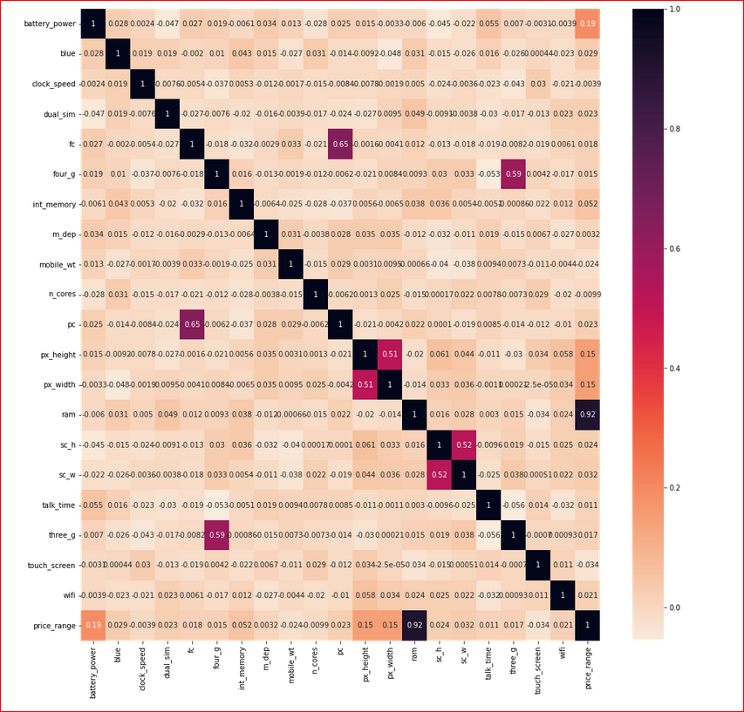
CHECKING CORRELATION BETWEEN EACH FEATURES IN DATASET

Slide 12
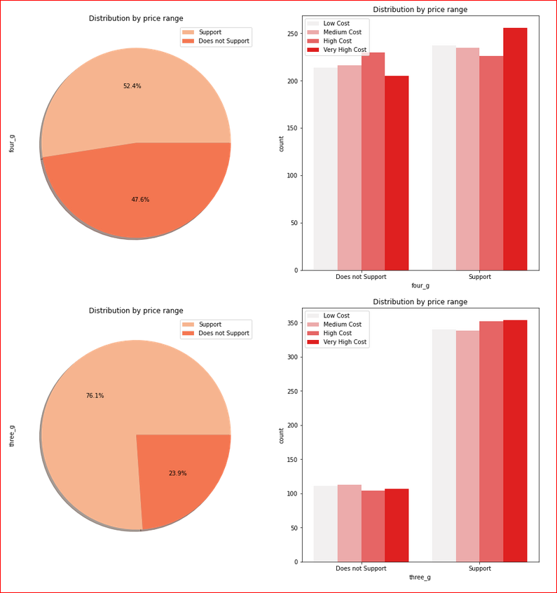
ABOVE GRAPH CHECK THE CONNECTIVITY OF 3G AND 4G ON MOBILES. DISTRIBUTION OF PRICE RANGE ALMOST SIMILAR OF SUPPORTED AND NON SUPPORTED FEATURE IN 4G . SO THAT IS NOT USEFUL OF PREDICTION. FEATURE 'THREE-G' PLAY AN IMPORTANT FEATURE IN PRICE PREDICTION.

Slide 13
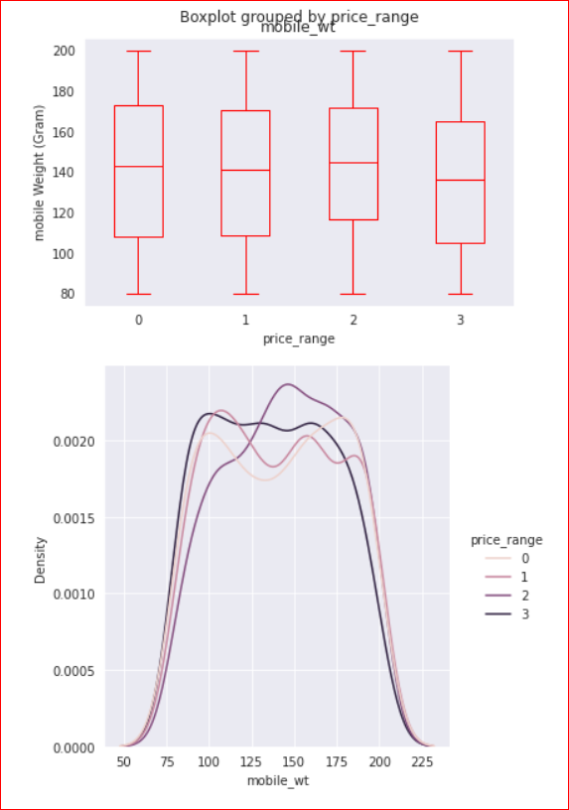
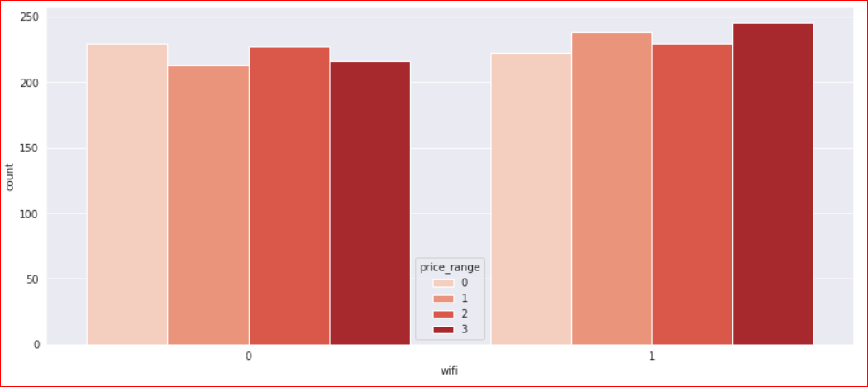
WE CAN SEE THAT IN THIS BOXPLOT, THE COSTLY PHONES ARE LIGHTER IN WEIGHT. IT SHOWS THAT MOST OF THEM HAVE WI-FI CONNECTIONS.

Slide 14
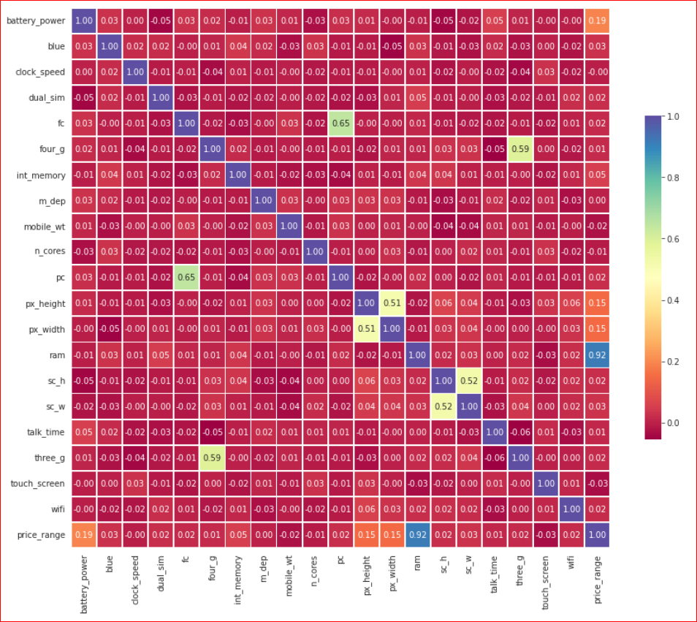
THE MOST INFLUENTIAL VARIABLE IS RAM. MOST OF THE VARIABLES HAVE VERY LITTLE CORRELATION TO PRICE RANGE. PRIMARY CAMERA MEGA PIXELS AND FRONT CAMERA MEGA PIXELS HAVE CORRELATION (IT MAKE SENSE BECAUSE BOTH REFLECT TECHNOLOGY LEVEL OF RESOLUTION OF THE RELATED PHONE MODEL, BUT THEY DO NOT AFFECT PRICE RANGE. HAVING 3G AND 4G IS SOMEWHAT CORRELATED. THERE IS NO HIGHLY CORRELATED INPUTS IN OUR DATASET, SO THERE IS NO MULTICOLLINEARITY PROBLEM.

Slide 15
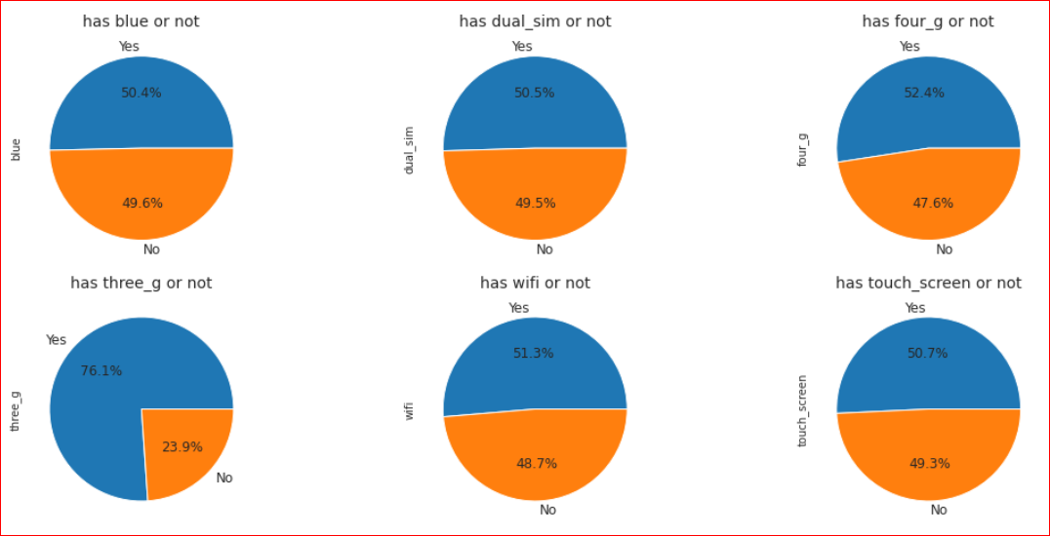
FEATURE ENGINEERING & DATA PRE-PROCESSING
1 MEANS IT HAS THE SPECIFICATIONS.
0 MEANS IT DO NOT HAVE THE SPECIFICATIONS.
PERCENTAGE DISTRIBUTION OF MOBILES HAVING BLUETOOTH, DUAL SIM, 4G,WIFI AND TOUCHSCREEN ARE ALMOST 50 %.VERY FEW MOBILES(23.9%) DO NOT HAVE 3G.

Slide 16
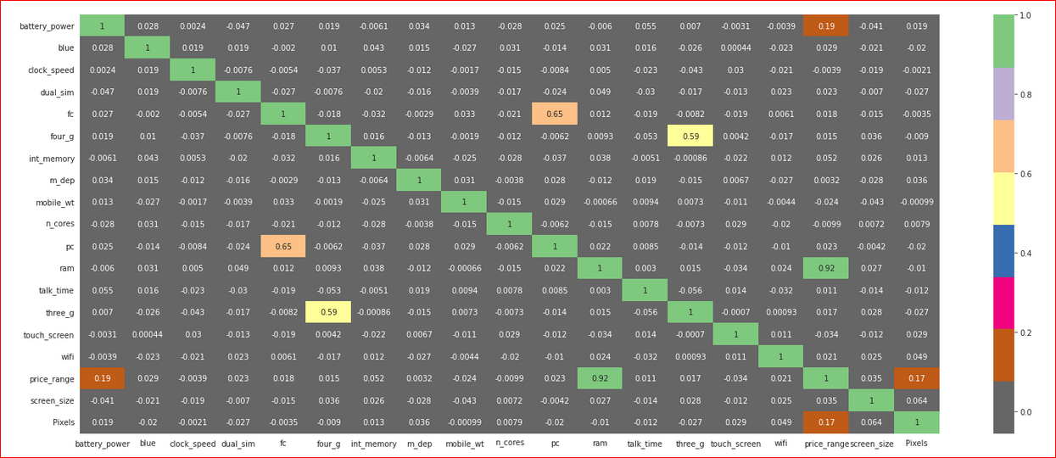
FEATURE SELECTION

Slide 17
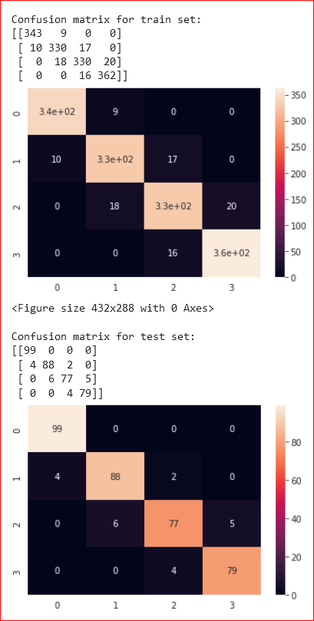
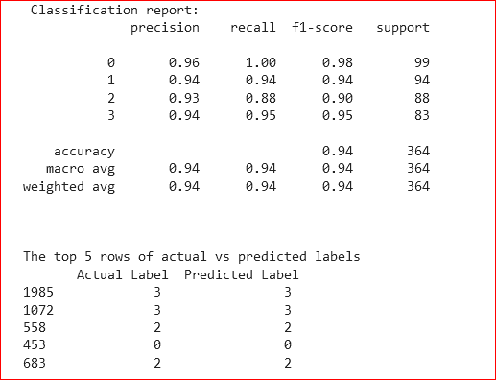
ML MODEL IMPLEMENTATION
ML MODEL – 1
BUILDING A LOGISTIC REGRESSION MODEL

Slide 18
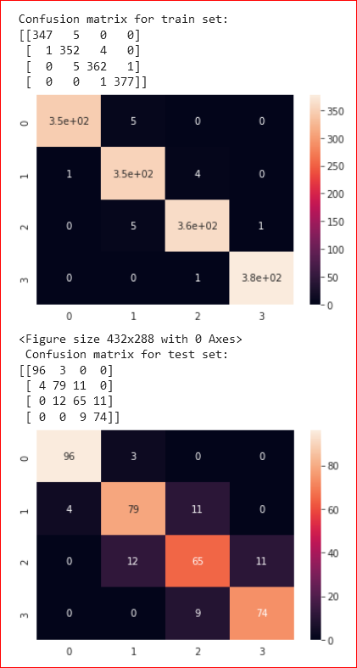
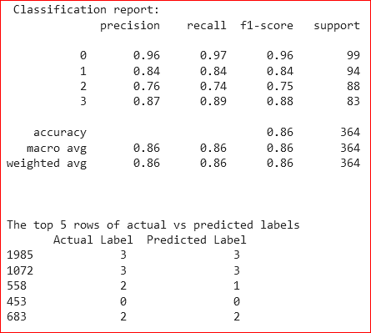
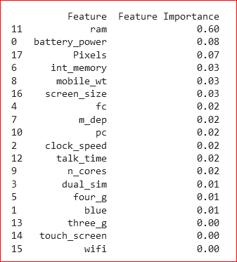
ML MODEL – 2
BUILDING A RANDOM FOREST CLASSIFIER MODEL

Slide 19
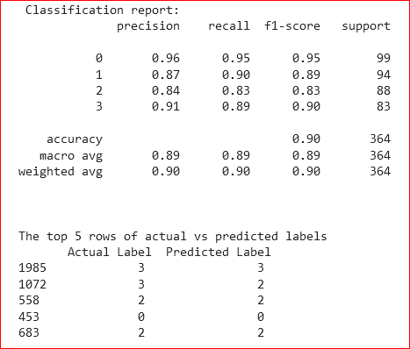

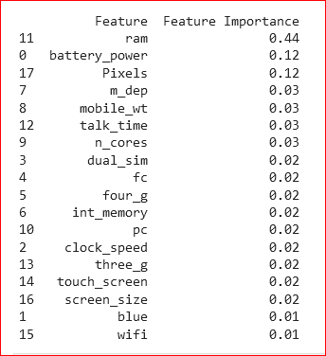
ML MODEL – 3
BUILDING A XG BOOST MODEL

Slide 20
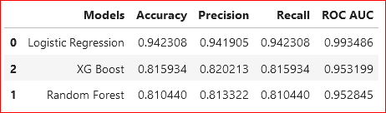
ACCURACY SCORE WILL BE THE BEST EVALUATION METRIC TO SELECT THE MODEL. LOGISTIC REGRESSION PERFORMS THE BEST AMONG THE THREE CLASSIFICATION METHODS USED. RANDOM FOREST AND XG BOOST PERFORM ALMOST SAME.
NOW COMPARING ALL THE MODELS

Slide 21
CONCLUSION
From EDA we can see that, there are cell phones in 4 price ranges.
The number of elements is almost similar.
Half the devices have Bluetooth, and half don’t.
There is a gradual increase in battery as the price range increases.
Ram has continuous increase with price range while moving from Low cost to Very high cost.
Costly phones are lighter.
RAM, battery power, pixels played more significant role in deciding the price range of cell phone.
I have implemented 3 classification models and achieved a good result for all the algorithms.
Logistic Regression
Random Forest
XG Boost
Logistic regression shows approx. accuracy of 90% and the other two shows approx. 80% accuracy, which shows that the data were properly classified.
Logistic Regression performed better than the other two model.

Slide 22
THANK YOU

